Slide 1


Slide 2

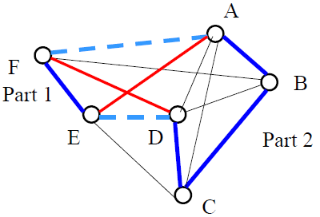
TSP represented by a graph
cities are labeled from 1 to n
using a genetic algorithm: search the shortest circuit visiting all cities exactly once
  Propose a suitable encoding of individuals.
  Define crossover and mutation operators.

Slide 3

Individual representation
  We should represent cities & order by which these cities are visited
  E.g. fixed size vector of visited cities
Fitness function
  We are interested in the shortest path
  Fitness function is based on sum of distance ∑d
    ∑d = D(1,5)+D(5,3)+D(3,2)+D(2,7)+D(7,6)+…..
    Fitness function= 1/∑d
1 | 5 | 3 | 2 | 7 | 6 | .......

Slide 4
Individual selection
  Selection is done based on fitness function
  E.g. select the individuals with best fitness
  Reproduction: Using crossover and/or mutation
  Crossover operation
    Random selection of crossing point
  Mutation operation
    Calculate offspring probability , if probability <0.001
    Mutate the off spring by swapping randomly select two gens

Slide 5

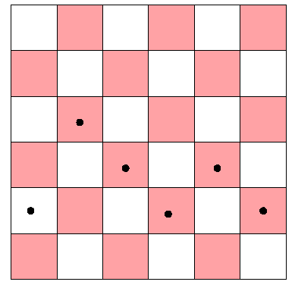
  Give the number of pairs of queen that are attacking.
  Explain how to do so that to reduce as much as possible the number of attacking pairs of queens.
Starting State

Slide 6

Number of pairs attacking =9
Reduce number of attacking using:
  Local search
    Hill climbing
    Stimulated annealing
    Local beam search
  Or Genetic Algorithm
    Individual representation: any arrangement of queens on the board knowing that every column contains one queen only
    Fitness function: 1/# of attacks

Slide 7

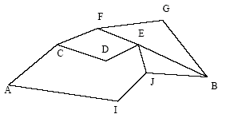
Route between cities may contain uphill, downhill and straight roads
  60 km/h in uphill roads
  120 km/h in downhill roads
  90 km/h in straight roads

Slide 8


Time in minutes
A,C | A,I | C,D | C,F | D,E | E,J | E,B | F,E | F,G | G,B | I,J | J,B
20 | 50 | 10 | 20 | 0 | 0 | 20 | 0 | 50 | 0 | 0 | 10
10 | 5 | 10 | 0 | 5 | 0 | 15 | 10 | 0 | 30 | 5 | 5
10 | 20 | 6 | 14 | 6 | 20 | 0 | 14 | 0 | 0 | 20 | 14
40 | 75 | 26 | 34 | 11 | 20 | 35 | 24 | 50 | 30 | 25 | 29

Slide 9


Time in minutes
A,B | C,B | D,B | E,B | F,B | G,B | I,B | J,B
40 | 30 | 30 | 40 | 40 | 20 | 20 | 10
20 | 15 | 10 | 0 | 5 | 15 | 0 | 5
20 | 12 | 8 | 0 | 8 | 0 | 8 | 8
80 | 57 | 48 | 40 | 53 | 35 | 28 | 23

Slide 10

Estimated
Real
  Heuristic overestimate real cost between DB,EB and GB
  It is not admissible
A,B | C,B | D,B | E,B | F,B | G,B | I,B | J,B
80 | 57 | 48 | 40 | 53 | 35 | 28 | 23
A,B | C,B | D,B | E,B | F,B | G,B | I,B | J,B
112 | 72 | 46 | 35 | 59 | 30 | 54 | 29

Slide 11

A,B | C,B | D,B | E,B | F,B | G,B | I,B | J,B
40 | 30 | 20 | 30 | 40 | 20 | 20 | 10
40 | 30 | 20 | 0 | 10 | 10 | 0 | 10
30 | 18 | 12 | 0 | 12 | 0 | 12 | 12
Time in minutes
A,B | C,B | D,B | E,B | F,B | G,B | I,B | J,B
40 | 30 | 20 | 30 | 40 | 20 | 20 | 10
20 | 15 | 10 | 0 | 5 | 5 | 0 | 5
20 | 12 | 8 | 0 | 8 | 0 | 8 | 8
80 | 57 | 38 | 30 | 53 | 25 | 28 | 23
Notes:
Change in DB,EB and GB

Slide 12

Estimated
Real
  Heuristic never overestimate real cost for every city
  It is admissible
A,B | C,B | D,B | E,B | F,B | G,B | I,B | J,B
80 | 57 | 38 | 30 | 53 | 25 | 28 | 23
A,B | C,B | D,B | E,B | F,B | G,B | I,B | J,B
112 | 72 | 46 | 35 | 59 | 30 | 54 | 29

Slide 13

Final Closed List [A I J]
Solution path A I J B
Order of node expansion A I J B
Not optimal solution

Slide 14

Final Closed List [A C I D E]
Solution path A C D E B
Order of node expansion A C I D E B
Optimal solution

